Slide 1

ETCAL
Award in Securing Progression
Unit B: Applying for Opportunities.
Mohaan.biswas@gateshead.ac.uk

Slide 2
Learning Outcomes
Understand the purpose of cover letters
Know how to complete an application form
Be able to use the STAR technique for competency based questions

Slide 3
Introduction - Unit Aim
This unit introduces and guides learners to identify, evaluate and progress applications. It encourages learners to make informed choices about the opportunities they might apply for, contributing positively to their potential career opportunities.
This unit will help learners to develop an understanding of the process and delivery of applications to secure opportunities. They will understand the personal qualities that are valued by employers and contribute towards securing and progressing their career.

Slide 4
Why do jobs require an application form and covering letter?

Slide 5
When to use a Covering Letter
To request an application form
To accompany a completed application form
With a CV in response to an advert
With a CV as a speculative application
Notes:
Covering letters that create a good first impression are well constructed, don’t contain any spelling mistakes or bad grammar, and support what you are saying in your CV. A good letter makes an employer sit up, take notice and want to read your CV. It will have more of an impact if it shows the employer that you have done your research. This means showing you know what the job involves and what they are looking for in an employee. Your letter will need to convince an employer that you want the job and that you’re the best person for it.

Slide 6
Cover Letter - What to include
What you are applying for
What experience you have that is relevant
A positive conclusion
Why you are applying
What skills you have that are needed/relevant
Encourage further contact
Knowledge of the company
What you can offer the employer
Prepare it. Get it checked. Send it in time.

Slide 7
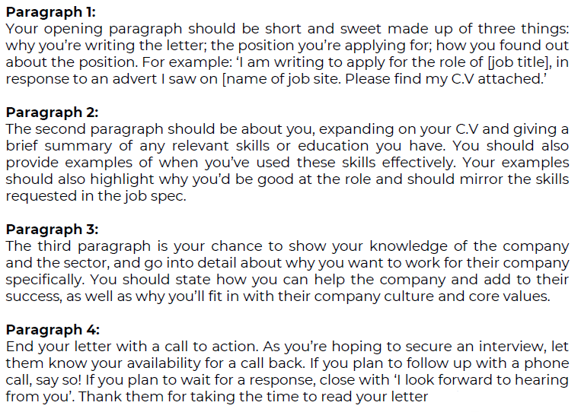
Cover Letter Structure

Slide 8
Identifying Suitable Opportunities
Information to look for in a job advert:
job description;
specific skills required;
specific qualifications;
location;
working hours;
salary and any other benefits;
details of how to apply for the job;
closing date for applications;
Promotion possibilities
Make sure you pay particular attention to the method of applications - this is just as important as the other aspects of the job advert.
Where might you see suitable adverts for jobs?

Slide 9
Types of application forms
Some employers prefer you to fill in an application form rather than send a CV. Forms are easier to compare because, unlike CVs, they follow the identical format.
Paper applications
Online applications
Notes:
Online application forms – Explain that if the form is online, draft your application offline first – in a word processing package like Word – and save it to your computer. This way you'll be able to run a spell check before you copy the information into the online system. It also means you'll have a back-up if there's a problem with the form. More and more sites offer the option of storing your application online and coming back to it. If you do this in more than one sitting, keep a record of any usernames and passwords so that you can get back in.
Paper based -If you’re filling in a form by hand, write as neatly as you can in black ink. Use block capital letters if the form asks you to.
A good way to avoid mistakes and crossings-out on the final form is to photocopy the original and practice filling in this copy first. Take care of the original form – don’t spill anything on it or leave it in your bag to get creased!

Slide 10
What information is often found on an application forms?
Personal information
(name, address, telephone, email)
Qualifications
References
Work experience
Employment history
Hobbies and interests
Previous roles and responsibilities
Additional information in support of application

Slide 11
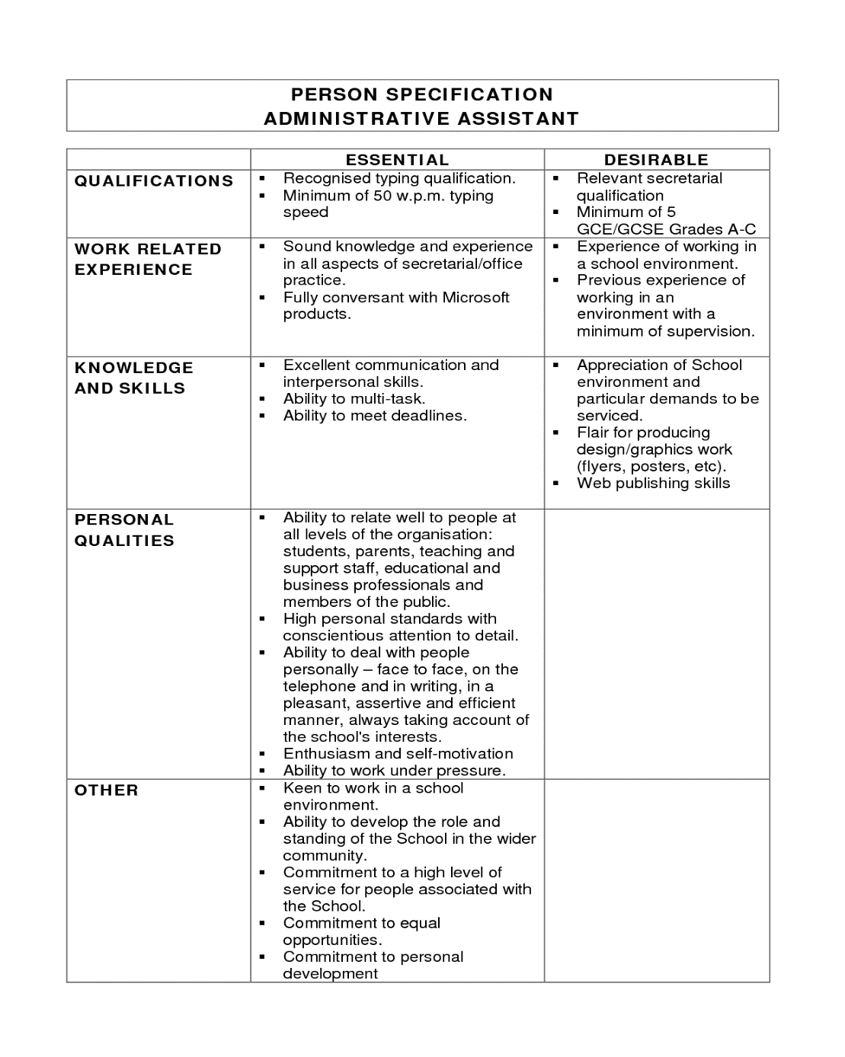
Employer requirements
Employers usually request specific skills or “competencies” in the Person specification, which they believe are needed to do the job.
It is very important that you address them in the application form.
Additional information section allows you to talk about your skills and experience that is relevant to the job.
Notes:
A person specification is written by the employer and outlines the type of person the firm wants. It might contain the educational qualifications, previous experience, general intelligence, specialised skills, interests and personality. The person specification is used to match the right person to the job and describes the desirable personal attributes of the job holder.
It is extremely important that you read the person specification before writing the application and think about how you match the skills that they are requesting. Try to give as many positive examples as possible in the additional section where it states “additional information” or “please give your reasons for applying for the job”
If you not mention that you match this criteria in your application form, you will not be shortlisted and invited for interview.

Slide 12
Evidencing criteria – back yourself up
Empty statement from an application form:
“I am the perfect person for the job and would fit in brilliantly with your team”
Link all your statements with facts.
Linked statement from an application form:
“I am the perfect person for the job. I have a variety of skills which include (X,Y & Z) These skills have been demonstrated during my previous role where I…

Slide 13
Use the STAR approach
Situation
Begin by giving context and describing the situation
Task
Describe the task you were working on. What was your goal?
Action
What did you do? What were YOUR specific actions?
Result
What was the end result? Be reflective. What have you learned that you will use in the future?
Notes:
When providing examples of skills, whether that be on a CV or in a job interview, using STAR will help to ensure that enough information is provided to give the employer a clear picture of how skills have been used/developed in the past.

Slide 14
Competency Based Questions
Using the STAR technique how would you answer this question:
“Tell us about a time you have had to think on your feet and solve a problem under pressure?”

Slide 15

Application form checklist
Check application form for spelling mistakes and get someone to check
Save a copy of your application to refer back to
Leave plenty of time before closing date. Some forms are long and tricky to complete
Do a practice form first – create a rough draft in word if online application

Slide 16
Activity
Now complete the Securing Progression Workbook…
Complete all questions within Unit B in the workbook.
Except Q6 - you will produce your final application next lesson after tutor feedback
Ensure all questions are fully answered and that correct English is used (grammar, spelling, etc.)
Answers should be suitable for the question – if it is asking for a description or explanation, then ensure you have given this and not just a bullet point list or single word answer.
Complete the Learner Feedback Page (see next slide…)

Slide 17
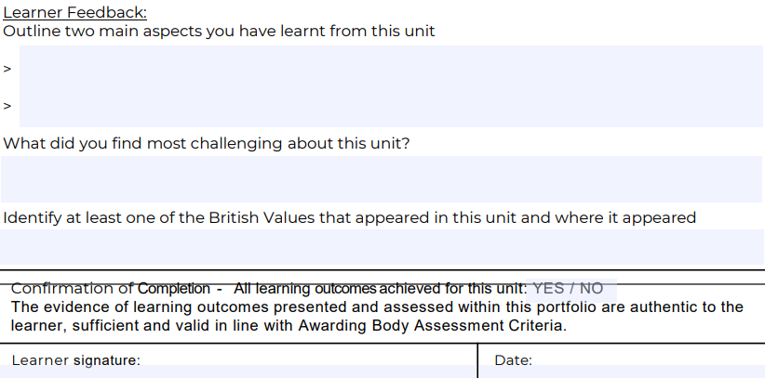
At the end of each unit…
Complete the ‘Learner Feedback’ section on the Assessment Feedback Sheet.
Sign the ‘Learner Signature’ box and add the date

